Slide 1
CHEG342 Mass Contactor Final Project
Reema Alyahmadi
Abdul Fayeed
Theodore Lambert
Elizabeth Votta

Slide 2
Introduction & Goals of the Design Process
Meet certain purification specifications for acetone removal from wastewater.
Develop an understanding of key parameters used in analysis and make logical design decisions to optimize performance.
Optimize the system based on a simple cost analysis that evaluates the running cost of the purification process.
Develop informative plots that aid in a thorough understanding of the problem being analyzed.
Evaluate the limitations of the specified design solution, and consider the effects of changing key variables in the design such as the mass transfer coefficient, k_{m}.

Slide 3
Important Purification Parameters and Outcomes
k_{m} is specified per the problem statement to be 3 x 10⁻⁵ m/s.
The role of k_{m} in the overall system design will be evaluated further, although its value does not change in the overall proposed design and is treated as constant.
The key objective for this system design is to reduce acetone concentration in wastewater from 35 g/L to at least 3 g/L.
The flow rate of the waste stream is given as q_{waste} = 250 L/min, where the purification stream (TCE) is an important design variable that is calculated later in the analysis.

Slide 4
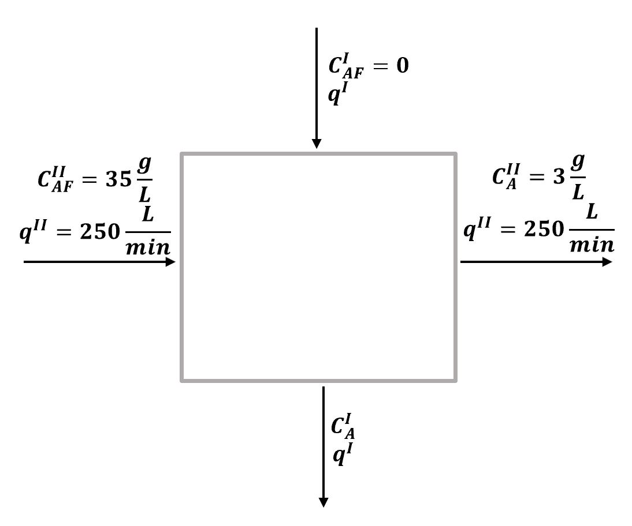
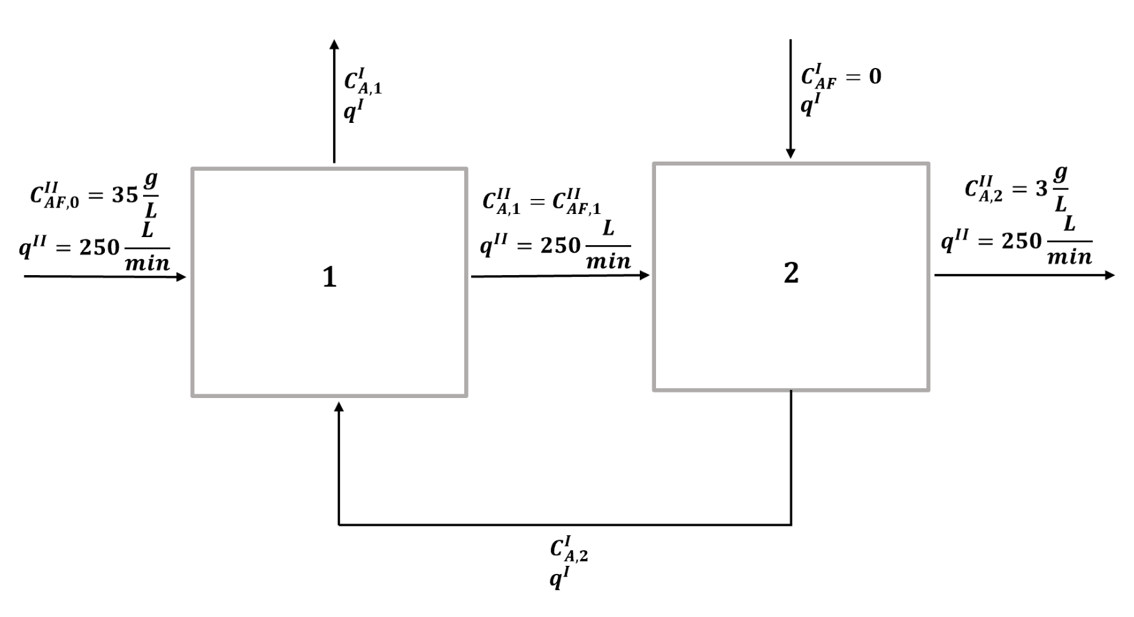
Design Schematics
Single-stage
Two-stage
I: Continuous phase/TCE
II: Dispersed phase/Wastewater stream
A: Acetone

Slide 5
Design Assumptions
General Procedure
The process is run at steady state operation
Analysis is completed for one full-day of operation (24 hrs)
Treat the system as well-mixed
Assume a negligible change in volume of each phase
Assume k_{m} to be constant over the iterations of design
Developed a set of balance equations to solve for desired variables.
Visualize a range of possible operating conditions to then optimize the system.
Perform a cost analysis of the range of systems being considered to determine optimum system design.

Slide 6
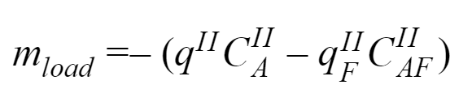
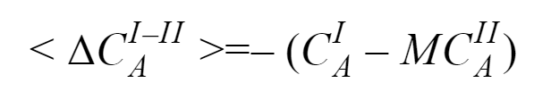
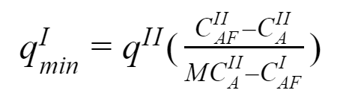
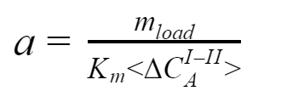
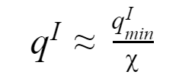
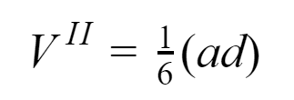
Analytical Approaches
Mass transfer load:
Minimum flow rate of TCE:
Flow rate of TCE:
4. Average driving force:
5. Interfacial area:
6. Volume of dispersed phase:

Slide 7
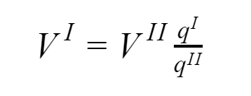

Analytical Approaches: Cont’d
7. Volume of continuous phase:
8. Total volume of tank:
Through use of these equations, a range of operating conditions were explored and plotted to determine the optimum operating conditions for this design system.
Analysis was done via MatLab.
Both single and two-stage systems were analyzed using this approach.

Slide 8
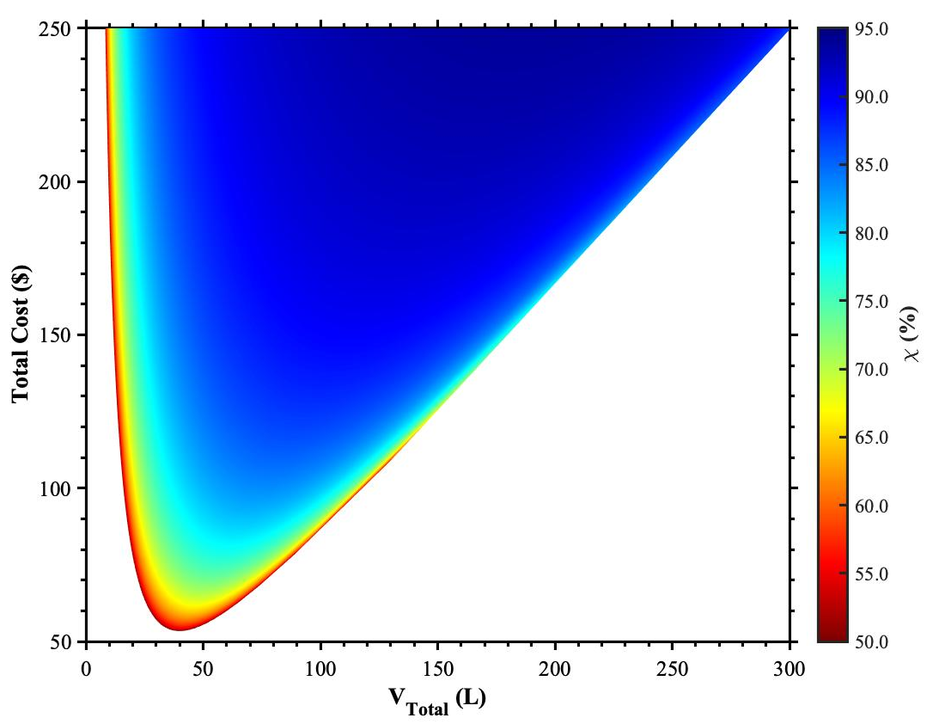
Single Stage Mass Contactor Analysis
For single-stage countercurrent operation, optimal efficiencies occur at high system volumes and high running costs.
If lower separation efficiency is acceptable, operating costs and system volume can be decreased.
This makes intuitive sense as the operational cost is largely dependent on the diameter of dispersed phase particles that are desired. The smaller the diameter, the more area for transfer, the more input power required to attain these conditions leading to higher efficiencies.
Total operating cost per day as a function of total system volume at varying stage efficiencies:

Slide 9
Single-Stage Contactor Design
Shown to the right is an example of a single-stage mass contactor.
This illustration highlights important parts of a real world mass contactor. This design includes a column where mixing between phases occurs, a rotating shaft with a turbine impeller which helps to achieve the ‘well-mixed’ assumption, and counter- current operation where the two phases are ran countercurrent to each other in operation for effective waste stream purification.
Image from: Koch Modular

Slide 10
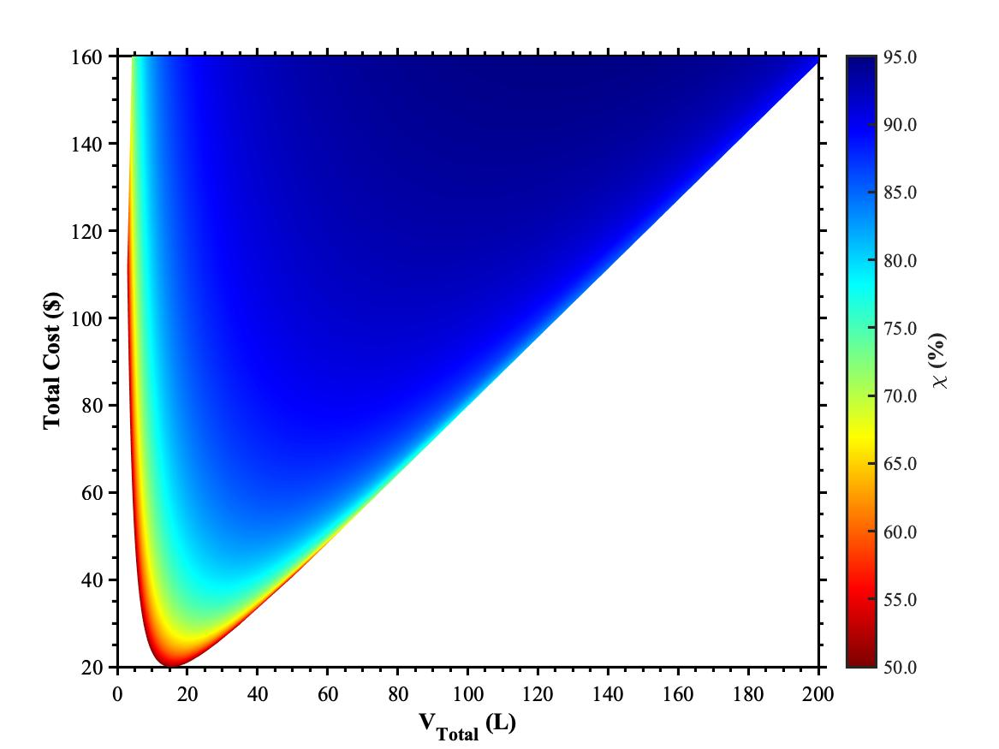
Two-Stage Mass Contactor Analysis
Total operating cost per day as a function of total system volume at varying stage efficiencies:
For two-stage countercurrent operation, optimal efficiencies occur at higher system volumes and higher operational costs, similar to the single-stage contactor system.
The drawback of high separation efficiency is slower total processing time for this treatment process. As volumes are very small for the very efficient systems, overall processing capacity would be diminished if high efficiency was required.
Compared to the single-stage system, similar efficiencies can be achieved with smaller total volume systems for two-stage systems. Capital cost would need to be evaluated though as running cost may be less for two-stage systems, but the capital cost may offset that for some period of time.

Slide 11
Cost Considerations
For the scope of this project, the cost to run this system includes the cost for TCE and the cost to power the process.
Daily operational costs were solely considered, but further analysis is warranted for future work to determine the cost basis for purification given different design systems.
Full system optimization would warrant a cost analysis including capital costs for specific systems being studied. While not explored in-depth for this analysis, projections for capital costs would be necessary if this system were to be implemented.

Slide 12
Further Specification of Design Parameter k_{m}
While the mass transfer coefficient, k_{m}, was assumed to be constant for the previous analysis, this assumption is a stretch, and it is more accurate to introduce a correlation for its value in the range of designs discussed previously.
Using the surface renewal theory, k_{m} can be correlated with the residence time via the following equation where D_{A} is the diffusivity term:
k_{m} = (D_{A}/𝜏)^{½}
As agitation in the mixing tank increases, the mass transfer rate will increase as a result, causing the residence time to decrease. The surface renewal theory then predicts that k_{m} will increase as agitation increases, and vice versa for the opposing scenario.
Further predictive methods relating Re, Sc, and Sh can be implemented to gather an empirical model for the system to predict the actual values that k_{m} would have over a range of desired agitations for the system being studied.

Slide 13
Conclusions and Recommendations
From the analysis, there are a wide range of operating conditions based on desired separation efficiency which in turn affect the operational costs of the system.
One & two-stage contactors showed similar trends where high system volume and high operational cost (power input) produce the greatest separation efficiency.
It is good practice to perform a more in-depth cost analysis to include capital cost of the system design, and its effect on the overall cost of the system.
A greater analysis of k_{m} is warranted to get the most clear picture of the systems being studied, since k_{m} is directly correlated with the amount of agitation in the system.

Slide 14
Questions?

